Slide 1
Platinum-Sensitive Relapsed Ovarian Cancer: New Options on the Horizon
Amit Oza, MD, FRCPC, MBBS
Princess Margaret Cancer Centre
Toronto, Ontario, Canada
www.prIMEoncology.org

Slide 2

Ovarian Carcinoma: Clinical Course
Interval
Cytoreduction
Progression
Diagnosis
Death
Symptoms
Chemo #1
Consolidation/
Maintenance
Chemo #2
Consolidation/
Maintenance
Chemo #3+
Supportive
Care
Staging
Primary cytoreduction
Notes:
2
2
After diagnosis of ovarian carcinoma, the clinical course generally follows a path that includes cytoreductive surgery and multiple cycles of chemotherapy treatment if the disease progresses. To distinguish between consolidation therapy and maintenance therapy, “consolidation” implies a very short course of a different form of therapy, and “maintenance” implies a more drawn-out course of a similar type of therapy.

Slide 3
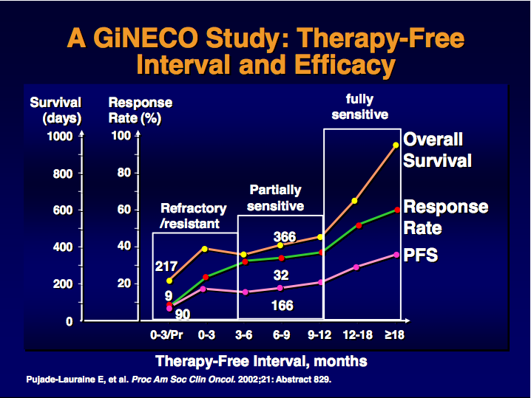
Recurrent Ovarian Cancer A GiNECO Study: Therapy-Free Interval and Efficacy
Pujade-Lauraine E, et al. Proc Am Soc Clin Oncol. 2002;21: Abstract 829.

Slide 4
Improving Systemic Therapy Following Recurrence: Sensitive Disease
Surgery?
Systemic therapy
Platinum Doublets
Trabectidin/PLD
Targeted agents - Concurrent +/- Maintenance:
Anti-angiogenics
Bevacizumab
Cedarinib
DNA repair inhibitors
Parp inhibitors
Wee 1 inhibitor?
Stem cell targets
Hedgehog Inhibitors
Immunotherapy

Slide 5
Ovarian Cancer Recurrence Treatment Algorithm
First-line therapy
carboplatin/paclitaxel IV
Cisplatin/paclitaxel IP
Platinum-sensitive (relapse >12 months)
Evaluate surgery
rechallenge: platin-based combination chemotherapy
PLD/carbo, gemcitabine/carbo, paclitaxel/carbo, trabectedin/PLD
Partially platinum-sensitive (relapse 6-12 months)
Platinum-resistant / refractory (relapse <6 months or no response)
PLD, topotecan, weekly carbo / paclitaxel or paclitaxel weekly Experimental drugs
2012: Bevacizumab
2014: Olaparib for mBRCA
Vergote I, et al. 2010 College of Oncology National Clinical Guidelines: Ovarian Cancer (Belgium). Available at: www.collegeoncologie.be/files/files/Ovarian_Cancer_V1.2010_(EN).pdf. Accessed: 2014 September 26.

Slide 6
Novel Approaches
Modulate the microenvironment
Leverage potential for synthetic lethality
Parp inhibition
TP53 targeting
Target driver mutations
Exploit unique expression on cells
Immunologic approaches
Explore potential to target stem cells

Slide 7
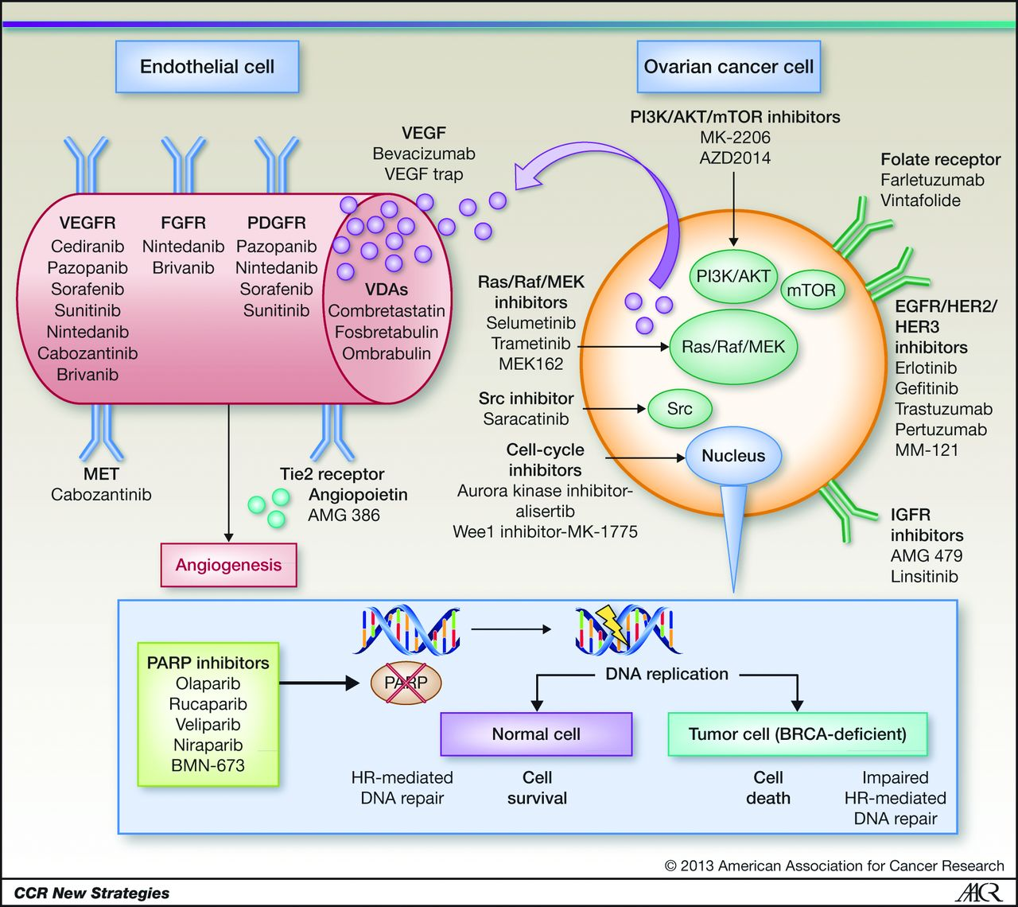
Targeted Therapies in Ovarian Cancer
Banerjee S, et al. Clin Cancer Res. 2013;19(5):961-968.
Notes:
Targeted therapies in ovarian cancer.

Slide 8
1st Platinum-Sensitive Relapse: Antiangiogenic Agents
Licensed: Carboplatin/gemcitabine + bevacizumab followed by maintenance bevacizumab
OCEANS¹:
Median PFS improvement 4 months, HR 0.48
No overall survival benefit seen
Other options: Cedirinib?
ICON6²:
Median PFS improvement 3.1 months, HR 0.57
Overall survival benefit 2.7 months, HR 0.7
1. Aghajanian C, et al. J Clin Oncol. 2012;30(17):2039-2045. 2. Lederman J, et al. Eur J Cancer. 2013;49(Suppl2) Abstract LBA10.

Slide 9
OCEANS: Primary Analysis of PFS
 | CG + PL (n = 242) | CG + BV (n = 242)
Events, n (%) | 187 (77) | 151 (62)
Median PFS, months (95% CI) | 8.4 (8.3-9.7) | 12.4 (11.4-12.7)
Stratified analysis HR (95% CI) Log-rank P value | 0.484 (0.388-0.605) <.0001
1.0
0.8
0.6
0.4
0.2
0
Proportion Progression Free
0
6
12
18
24
30
No. at risk
Months
CG + PL
242
177
45
11
3
0
CG + BV
242
203
92
33
11
0
Aghajanian C, et al. J Clin Oncol. 2012;30(17):2039-2045.
Notes:
9

Slide 10

Progression-Free Survival – All Three Arms
 | Chemo. | Conc. | Maint.
PFS events, n (%) | 112 (94.9) | 152 (87.4) | 139 (84.8)
Median, months | 8.7 | 10.1 | 11.1
Log-rank test (trend) | P = .0003
HR vs. Chemo only (95% CI) |  | 0.67 (0.53-0.87) | 0.57 (0.44-0.74)
Restricted means, months | 9.4 | 11.4 | 12.5
Maintenance
Chemotherapy
Concurrent
Chemo.
Conc.
Maint.
Ledermann JA, et al. Eur J Cancer. 2013;49(Suppl 3):Abstract LBA 10.
Notes:
Log-rank test (trend) p=0.00003
Test for non-proportionality p=0.06
Treatment effect estimate with non-proportional hazards:
Restricted mean survival time (RMST)
Increase of 1.9 months from 9.4 to 11.4 with concurrent treatment over chemotherapy only
Increase of 3.1 months from 9.4 to 12.5 with maintenance treatment over chemotherapy only
Increase of 1.1 months from 11.4 to 12.5 with maintenance treatment over concurrent
Treatment effect estimate with proportional hazards:
Cox hazard ratio (HR)
HR=0.68 (0.53 , 0.87) for chemotherapy only compared to concurrent treatment
HR=0.57 (0.44 , 0.73) for maintenance compared to chemotherapy only treatment
HR=0.83 (0.66 , 1.05) for concurrent compared to maintenance treatment

Slide 11
Overall Survival
Restricted mean survival time increases by 2.7 months with maintenance treatment (over two years)
Maintenance
Chemotherapy
 | Chemo. |  | Maint.
OS events, n (%) | 63 (53.3) |  | 75 (45.7)
Median, months | 20.3 |  | 26.3
Log-rank test | P = .042
HR (95% CI) | 0.70 (0.51-0.99)
Test for non-proportionality p=0.0042
Restricted means, months |  | 17.6 |  | 20.3
Chemo.
Maint.
Ledermann JA, et al. Eur J Cancer. 2013;49(Suppl 3):Abstract LBA 10.

Slide 12
Platinum-Sensitive Relapse Treatment Options
Antiangiogenic agents or PARP inhibitors?
Platinum-sensitive relapse
May be in situation where patients can either have bevaciuzmab or PARP inhibitor
Do BRCA carriers derive the same benefit from antiangiogenic agents as non-BRCA carriers?
Is response to PARP inhibitor affected by prior antiangiogenic agent?
URGENT NEED FOR BIOMARKER
Potential for molecular subgroups within high-grade serous predicting outcome with bevacizumab (Gourley C, et al. J Clin Oncol. 2014;32(5S): Abstract 5502.)

Slide 13




Ovarian Cancer Treatment Algorithm
FRONT-LINE
Stage IIIb–IV
Bevacizumab
+ chemo
If anti-VEGF naive
How to integrate the new agents (PARP-inhibitors)??
Disease progression
Chemo and/or other biologic, or bevacizumab
(if Mito 16-MaNGO-02 positive)
RECURRENT
Bevacizumab
+ chemo
platinum
sensitive
platinum
resistant

Slide 14

Looking at the Future: Ovarian Cancer Treatment Algorithm
FRONT-LINE
Stage IIIb–IV
Bevacizumab
+ chemo
Disease progression
BRCA testing
M +
WT
Olaparib + chemo
RECURRENT
Bevacizumab
+ chemo
platinum
sensitive
platinum
resistant

Slide 15
Platinum-Sensitive Relapse: Cediranib + Olaparib
Preclinical data potential synergy between PARPi and antiangiogenics
PARPi VEGFR2; VEGFR2i hypoxia HR PARPi sensitivity
Phase II open-label randomized study
1:1 randomization to cediranib/olaparib combination or single-agent olaparib
Platinum-sensitive recurrent ovarian, fallopian tube, or primary peritoneal cancer
Platinum-sensitive, recurrent OC
High-grade serous/endometrioid
No prior PARPi
No prior AA for recurrence
No platinum limit
Olaparib capsules 400 mg BID
Randomize 1:1
Disease progression by RECIST v1.1 criteria
Cediranib 30mg daily + Olaparib capsules 200mg BID
Liu J, et al. J Clin Oncol. 2014;32(5S): AbstractLBA5500.

Slide 16
Primary Outcome: Cediranib/Olaparib Significantly Increased PFS Compared to Olaparib Alone
1.0 –
0.8 –
0.6 –
0.4 –
0.2 –
0.0 –
+ Censored
 | Olaparib | Ced/Olap
PFS events | 28 | 19
Median PFS | 9.0 mo | 17.7 mo
P = .005
HR 0.42 (95% CI: 0.23-0.76)
Cediranib/
olaparib
Proportion Progression-Free
Olaparib
46 26 13 6 1 0
44 37 24 11 3 0
0 5 10 15 20 25 30
Months
Arm | ORR
 | N | %
Olaparib alone | 22 | 47.8
Cediranib/olaparib | 35 | 79.6
 | P = .002
Liu J, et al. J Clin Oncol. 2014;32(5S): AbstractLBA5500.

Slide 17
Cediranib/Olaparib Significantly Increased PFS in Patients Without a BRCA Mutation
BRCA Mutation Carrier
BRCA Noncarrier/Unknown
1.0 –
0.8 –
0.6 –
0.4 –
0.2 –
0.0 –
1.0 –
0.8 –
0.6 –
0.4 –
0.2 –
0.0 –
+ Censored
+ Censored
Cediranib/
Olaparib
Cediranib/
Olaparib
Proportion Progression-Free
Proportion Progression-Free
Olaparib
Olaparib
24 18 9 5 1 0
23 20 15 7 3 0
22 8 4 1 0
21 17 9 4 0
0 5 10 15 20 25 30
0 5 10 15 20 25
Months
Months
 | BRCA Mutation Carrier |  | BRCA Noncarrier/Unknown
 | Olaparib | Ced/Olap | Olaparib | Ced/Olap
PFS events | 13 | 10 | 15 | 9
Median PFS | 16.5 mo | 19.4 mo | 5.7 mo | 16.5 mo
 | P = .16 |  | P = .008
 | HR 0.55 (95% CI: 0.24-1.27) |  | HR 0.32 (95% CI: 0.14-0.74)
Liu J, et al. J Clin Oncol. 2014;32(5S): AbstractLBA5500.

Slide 18
Normal TP53 Function
DNA Damage
Chemical carcinogens, UV, X irradiation
p53
DNA repair
Cell cycle arrest
Apoptosis
Maintenance of genomic integrity
HGS Ovarian Cancer
Mutations in >96%
?Functional

Slide 19
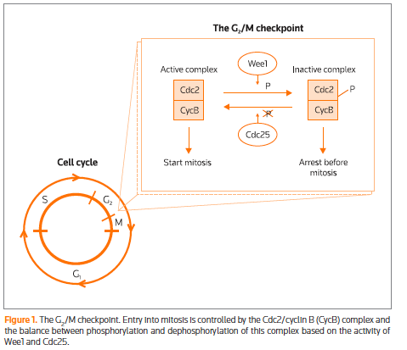
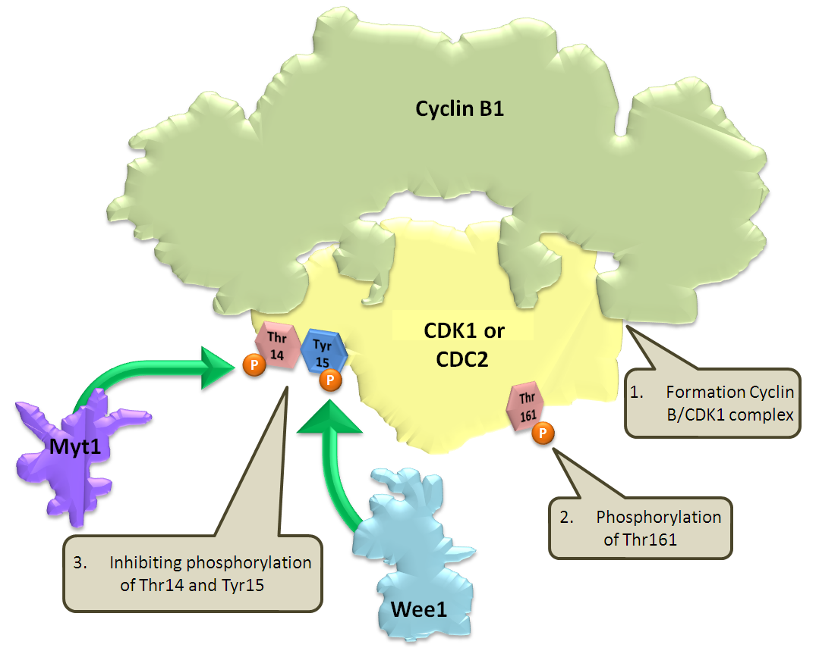
AZ-1775 Compound Profile
First in class
Potent, highly selective and ATP competitive Wee1 kinase inhibitor (IC50 = 5.2 nM) with selectivity over other G2/M kinases (~100-200x)
Potent context specific sensitizer to variety of DNA damaging agents (chemotherapy, radiation) in multiple cell lines (colon, ovarian, breast) in vitro and in vivo
Activity only in p53(-) cells not in p53 WT = context specificity

Slide 20
Scientific Rationale for AZ-1775 Combination Therapies
DNA Damage
p53
Wee1
AZ-1775
Normal
(p53 WT)
Arrest
G1
S
G2
M
DNA Damage
Wee1
AZ-1775
Tumor
(p53 mutant)
Mitotic catastrophe
G1
S
G2
M
Notes:
CCNE1/2: Cyclin E1/2; complex with and functions as a regulatory subunit of CDK2
CLSPN = cell cycle regulator, activates CHK1 in response to DNA damage
MCM10 = involved in S-Phase progression; interacts with chromatin during S-phase and dissociates during G2
HIST1H2BD = Histone, responsible for chromosome coiling
EGR1 = Early Growth Response
This slide shows the concept for Wee1 inhibitor.
Simplified hypothesis is shown here.
DNA damage induces cell cycle arrest by p53 and Wee1 dependent pathway in G1 and G2/M.
In p53- cells, DNA damage induces G2 arrest by Wee1 dependent pathway.
In this situation, inhibition of Wee1 induces Mitotic progression without fixing DNA damage and induces cell death called mitotic catastrophe.
In normal cells, Wee1 inhibition would induce minimal effect because they have p53 dependent pathway.
Therefore We think Wee1 inhibitor specifically sensitize p53- cells to DNA damage by abrogation of G2 DNA damage checlpoint.

Slide 21
A Randomized, Phase II Study Evaluating AZ-1775 in Combination With Paclitaxel and Carboplatin vs Paclitaxel and Carboplatin Alone in Adult Patients With Platinum Sensitive p53 Mutant Ovarian Cancer
Prospective enrollment of P53 mutant patients based on p53 testing by Amplichip
2-4L platinum sensitive disease
Endpoints: Primary EP: PFS
Secondary EP: OS
FPI: August 2011
Efficacy Analysis:
- N = 80, Power 80%
- 38 PFS events, 18 months
- HR 0.5, α = 0.1
AZ-1775
+ Carbo/Taxol
AZ-1775 +
Carbo/Taxol
R
Placebo
+ Carbo/Taxol
Part 1, Run-in
Part 2, Randomized comparison
N = 80

Slide 22
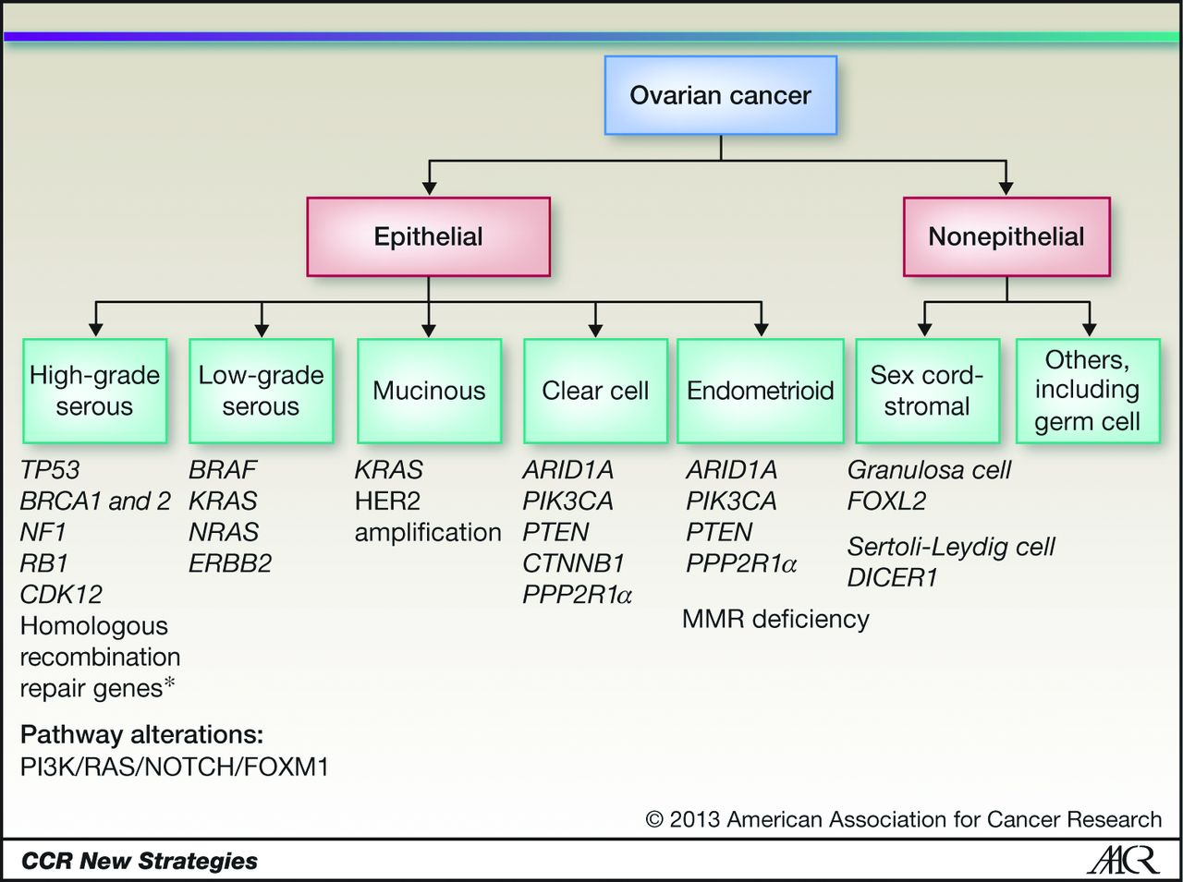
Histologic Subtypes of Epithelial Ovarian Carcinoma and Associated Mutations/Molecular Aberrations. *, CHK2, BARD1, BRIP1, PALB2, RAD50, RAD51C, ATM, ATR, EMSY, Fanconi Anemia Genes
Banerjee S, et al. Clin Cancer Res. 2013;19(5):961-968.
Notes:
Histologic subtypes of epithelial ovarian carcinoma and associated mutations/molecular aberrations. *, CHK2, BARD1, BRIP1, PALB2, RAD50, RAD51C, ATM, ATR, EMSY, Fanconi anemia genes. MMR, mismatch repair. References 22, 34, 44, 58–65.

Slide 23
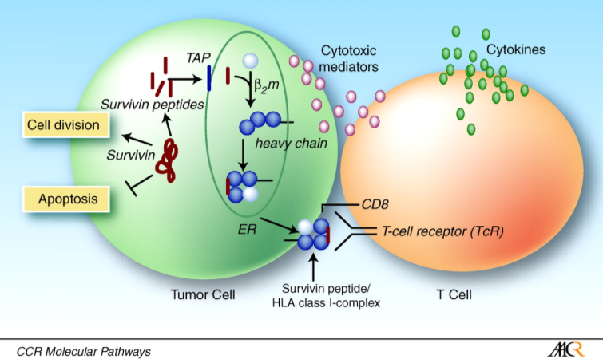
Survivin
Anderson MH, et al. Clin Cancer Res. 2007;13(20):5991-5994.

Slide 24
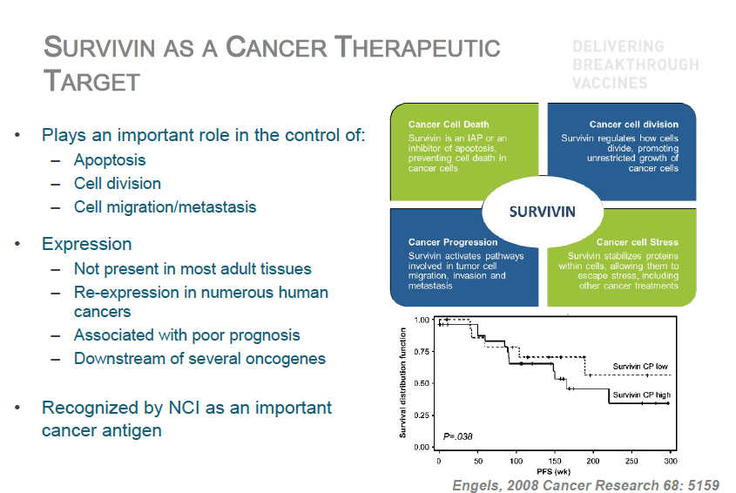
Survivin as a Cancer Therapeutic Target
Plays an important role in the control of:
Apoptosis
Cell division
Cell migration/metastasis
Expression
Not present in most adult tissues
Re-expression in numerous human cancers
Associated with poor prognosis
Downstream of several oncogenes
Recognized by NCI as an important cancer antigen
Engels K, et al. Cancer Res. 2008;68(13):5159-5166.

Slide 25
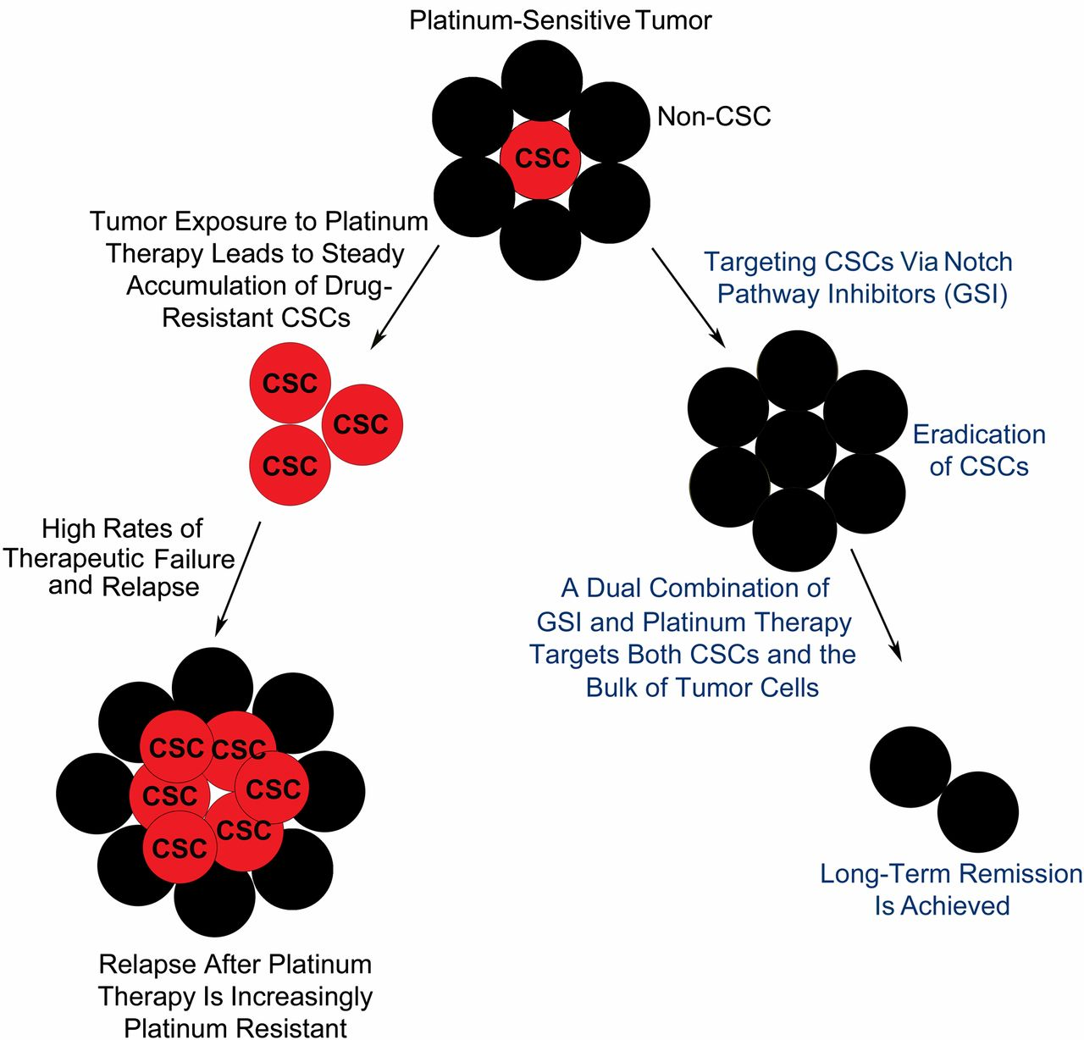
CSCs Are an Important Contributor to Tumor Chemoresistance Because of Their Ability to Survive Platinum-Based Chemotherapies
McAuliffe SM, et al. Proc Natl Acad Sci U S A. 2012;109(43):E2939-E2948.
Notes:
CSCs are an important contributor to tumor chemoresistance because of their ability to survive platinum-based chemotherapies. Current platinum therapies target the bulk of non-CSC tumor cells, thus reducing tumor mass but leaving behind platinum-resistant CSCs. Accumulation of drug-resistant CSCs might explain why the vast majority of ovarian cancer patients relapse after chemotherapy and become increasingly platinum resistant. Consequently, successful tumor remission requires a dual combination therapy that targets and eliminates both CSCs and non-CSC tumor cells.

Slide 26
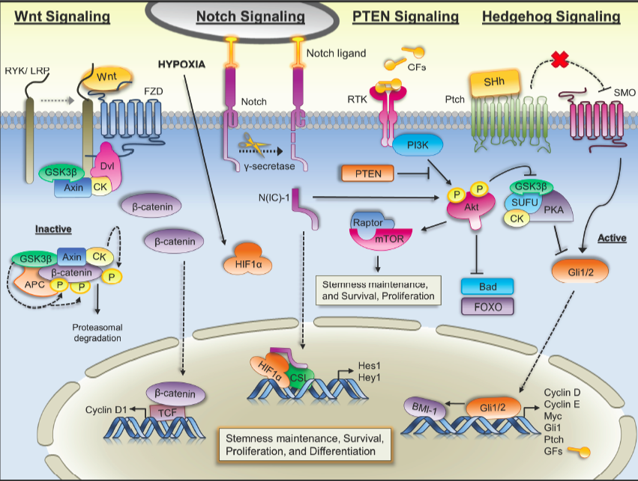
Templeton AK, et al. Stem Cell Invest. 2014.

Slide 27
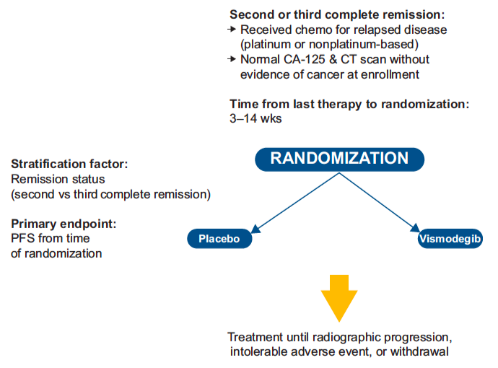
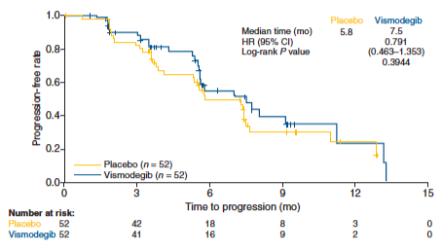
A Phase II, Randomized, Placebo-Controlled Study of Vismodegib as Maintenance Therapy in Patients With Ovarian Cancer in Second or Third Complete Remission
Kaye SB, et al. Clin Cancer Res. 2012;18(23):6509-6518.

Slide 28

Drug Development Program
Funding
N01 Contract – US NCI
Cancer Care Ontario
US Dept of Defense – Ovarian Cancer Translational Grants
OICR – Translational Research
PMH Foundation
Bras Family

